Slide 1
Plagiarism Detection on Clough-Stevenson corpus dataset
Esther Raja Kumari Katti
Koustubh Vijay Kulkarni

Slide 2
Definition:
Plagiarism is the "wrongful appropriation" and "stealing and publication" of another author's "language, thoughts, ideas, or expressions" and the representation of them as one's own original work.
With the advancement of internet, easy availability of the computers over the globe has made it easy to access other’s work which results in plagiarism.

Slide 3
Dataset Description:
Clough-Stevenson corpus dataset
Two files
Corpus csv file
100 text files
Text File:
100 files
95 answers provided by 19 students for 5 questions
one answer for each question from wikipedia

Slide 4

Corpus File :
Category :
Non: Non plagiarized work
Cut: Answers which are copy pasted from Wikipedia
Light: Light copy from Wikipedia but extreme changes in structure
Heavy: Heavily copied from Wikipedia

Slide 5
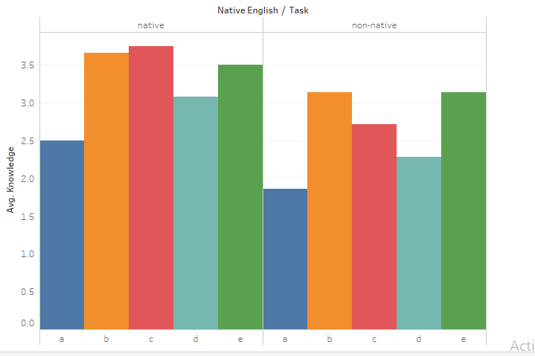

Slide 6
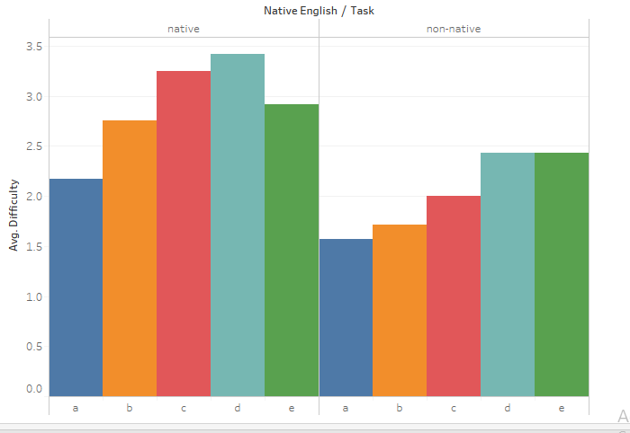

Slide 7
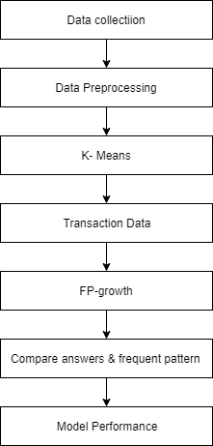
Approach:

Slide 8
Data Processing :
The problem with textual data is that it needs to be represented in a format that can be mathematically used in solving some problem.
We need to get an integer representation of a word.
We can model our text data into vectors using word vector representation techniques.
Also, we need to remove stop words and convert words into lowercase from the data.

Slide 9
Data Processing :
GloVe- Global Vectors For Word Representations
An unsupervised learning algorithm for generating word embeddings by aggregating global word-word co-occurrence matrix from a corpus.
These word embeddings show interesting linear substructures of the word in vector space.
GloVe uses Euclidean distance (or cosine similarity) between two word vectors as an method for measuring the linguistic or semantic similarity of the corresponding words.
Libraries Used- nltk, glove, sklearn.manifold, matplotlib

Slide 10
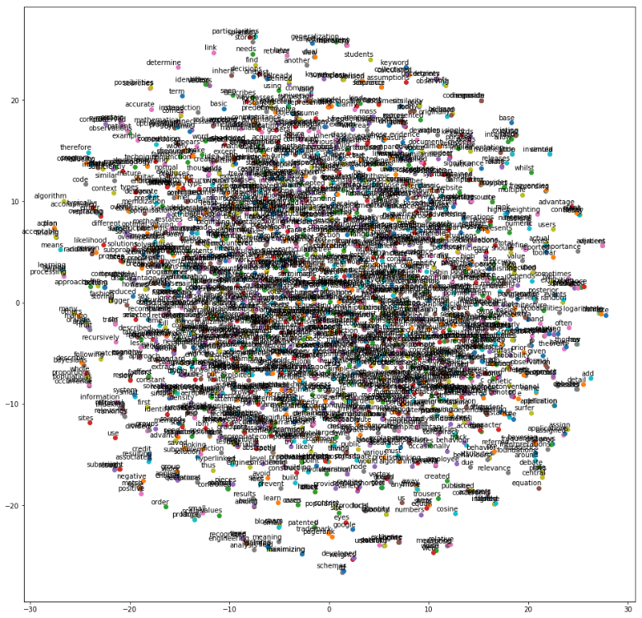

Slide 11
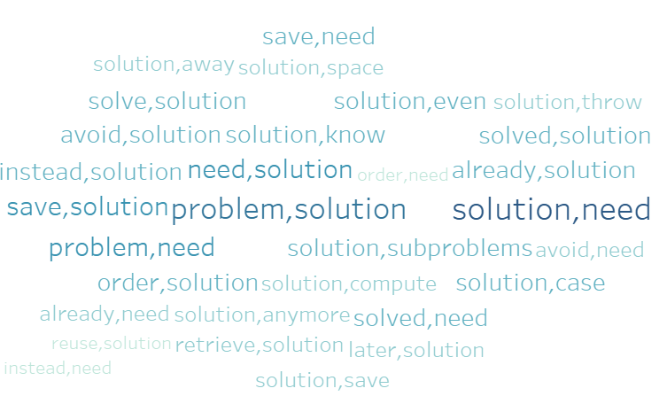

Slide 12
K- Means
Vectors file generated will be given as input to the K- means
Scikit-learn implementation of K-Means returns an object that indicates the cluster to which each input vector belongs.
Thus after performing K-means clustering, we get similar word clusters.
Libraries used- sklearn.cluster, numpy, pandas

Slide 13
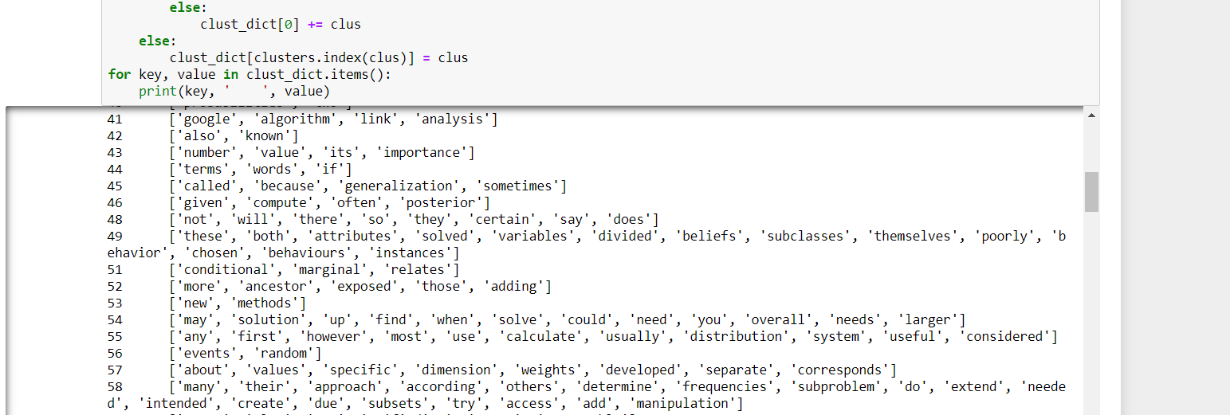
Word Clusters

Slide 14
Converting to Transaction Data
Determine the cluster label for each of the word in sentences and substitute the word with its respective cluster label.
From the above step, we merge all the words and form sentence vectors.
From these sentence vector, we form answer vector by assigning a unique number if two sentence vectors are same we assign each of them the same number.
Thus we get a vector for each answer. This vector can be viewed as an item-set and each answer can be viewed as a transaction. Thus we get a list of transactions which contain item-sets.

Slide 15
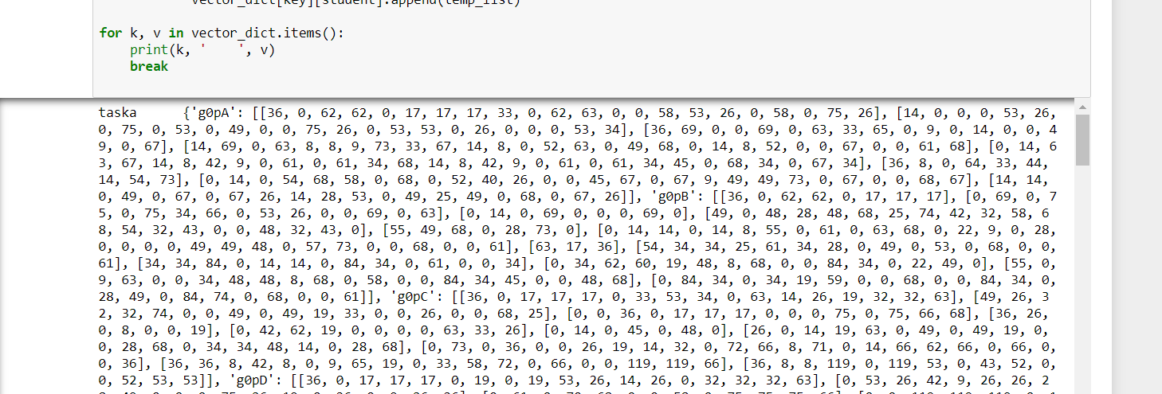
Sentence Vectors

Slide 16
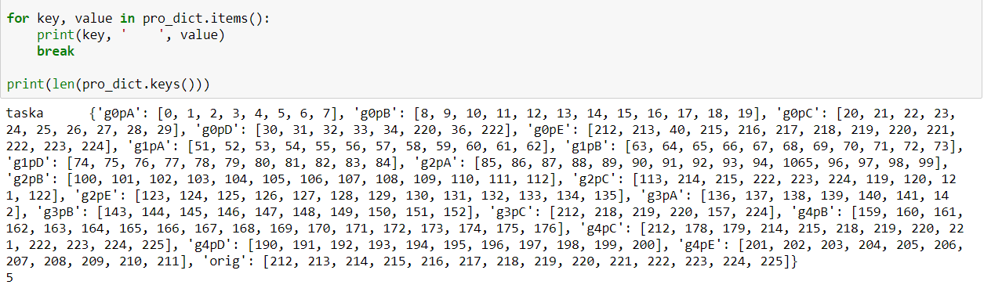
Answer Vectors

Slide 17
FP- growth algorithm
FP-Growth:
It allows frequent itemset discovery without candidate itemset generation. It’s a two step approach:
Step 1: Build a compact data structure called the FP-tree
Built using 2 passes over the data-set.
Step 2: Extracts frequent itemsets directly from the FP-tree

Slide 18
FP-Tree Construction
FP-Tree is constructed using 2 passes over the data-set:
Pass 1:
Scan data and find support for each item and discard the infrequent items
Sort frequent items in decreasing order based on their support.
Pass2:
Nodes correspond to items and have a counter
FP-Growth reads 1 transaction at a time and maps it to a path use a fixed order if paths overlap increment the counter.
The more paths that overlap, the higher the compression. FP-tree may fit in memory and frequent itemsets extracted from the FP-Tree.
Library Used: pyfpgrowth

Slide 19
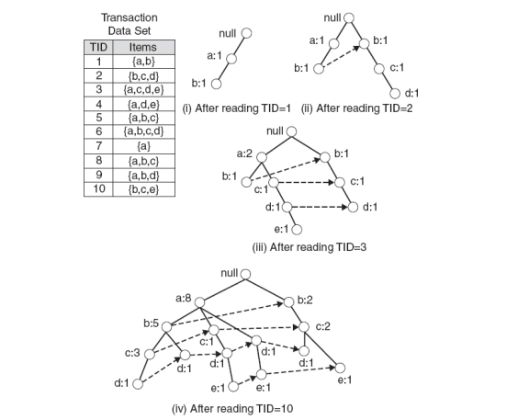
Example:

Slide 20
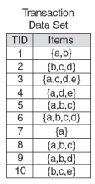
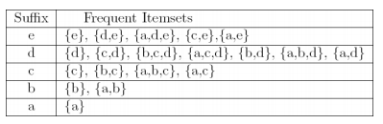
Frequent Itemsets generated:
Frequent itemsets found (ordered by suffix and order in which they are found):

Slide 21
Is it Copied?
In our context we get frequent sentences which are plagiarized. We can find which sentences are copied by just looking at the transactions which in our case are student answers.
But we need to consider only three or more frequent item-sets meaning only three or more frequent sentences.
This is because most of the students can have one one or two sentences in common like "This is called Inheritance". We cannot penalise students for that.

Slide 22
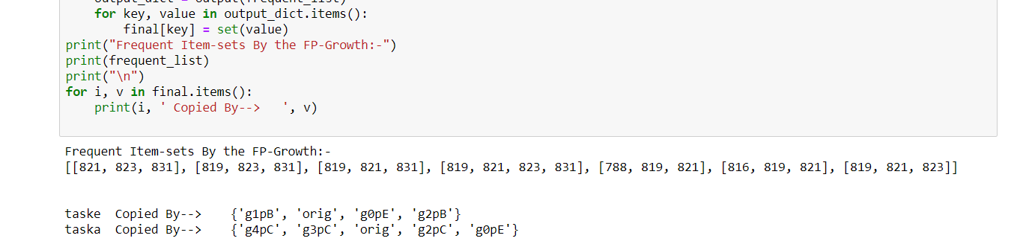
Frequent Item Sets

Slide 23



Example:
I love studying. I am hardworking .
I am best .I am Intelligent. I am attractive
I am best. I am Intelligent. I am attractive

Slide 24
Word Clusters
2:Attractive
1:Best
3.Intelligent
4.I
5.Love
6.Hardworking
7.Am
8.Studying

Slide 25
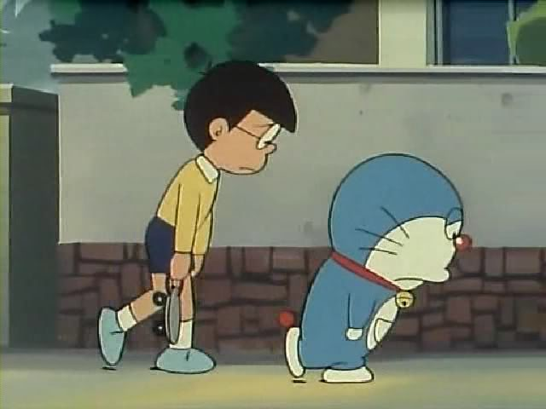
Sentence & Answer Vectors
Sentence Vector:
I am best: 4 7 1 – 1
I am best : 4 7 1- 1
I love Studying: 4 5 8 - 2
Answer Vector:
Doreamon: 1 2 3
Shisuka: 4 5
Nobita: 1 2 3
4 7 1.4 7 3.4 7 2
4 5 8.4 7 6
4 7 1.4 7 3.4 7 2

Slide 26
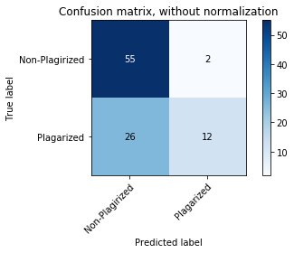
Performance:
Accuracy | 70.52%
Precision | 85.71%

Slide 27
Results:
Task Name | Copied By
Task E | g0pE, g2pB, g4pB, g1pB
Task A | g4pC, g3pC, g2pC, g0pE
Task B | g1pD, g4pE
Task C | g0pB
Task D | g3pA, g2pA, g4pC

Slide 28
Future Work:
Currently we are not showing how much percentage of answer is copied by particular individual. We can take it up as next step.
As an extension to this work, we can include vector representations using other techniques such as word2vec.
Another future work is to change the domain from documents to programming. In programming, we would need stricter noise removal as well as the support count of FP-growth algorithm will increase.

Slide 29
References
Dataset-https://ir.shef.ac.uk/cloughie/resources/plagiarism_corpus.html#Download
https://medium.com/@japneet121/word-vectorization-using-glove-76919685ee0b
http://techscouter.blogspot.com/2017/10/word-vectorization.html
J. Han, H. Pei, and Y. Yin. Mining Frequent Patterns without Candidate Generation. In: Proc. Conf. on the Management of Data (SIGMOD?00, Dallas, TX). ACM Press, New York, NY, USA 2000
https://towardsdatascience.com/emnlp-what-is-glove-part-ii-9e5ad227ee0
https://www.researchgate.net/publication/220147549_Developing_a_corpus_of_plagiarised_short_answers

Slide 30
Critical Questions
Which other algorithm can we use instead of FP-growth ? Discuss pros and cons.
What effect will have on Accuracy if we increase no. of clusters? Decrease or increase?

